Slide 1
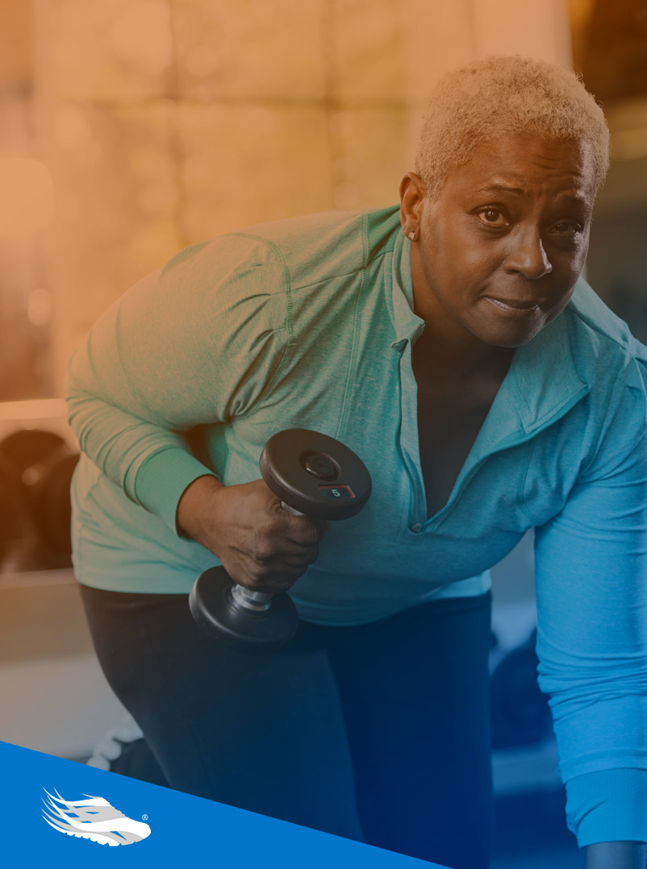
SilverSneakers®
Notes:
Hello and welcome to SilverSneakers the nation’s leading exercise program designed exclusively for you and available at no additional cost.

Slide 2
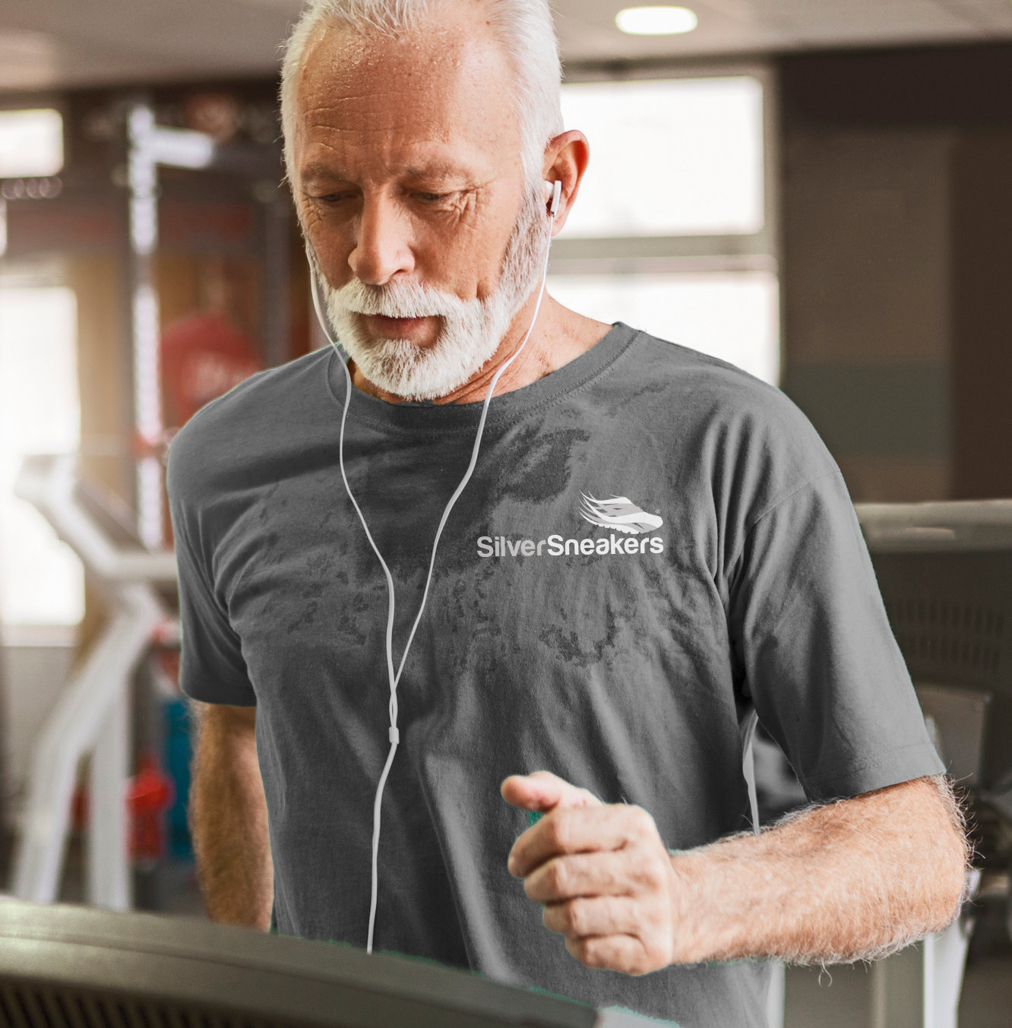
Engage with SilverSneakers in your:
GYM
COMMUNITY
HOME

Slide 3
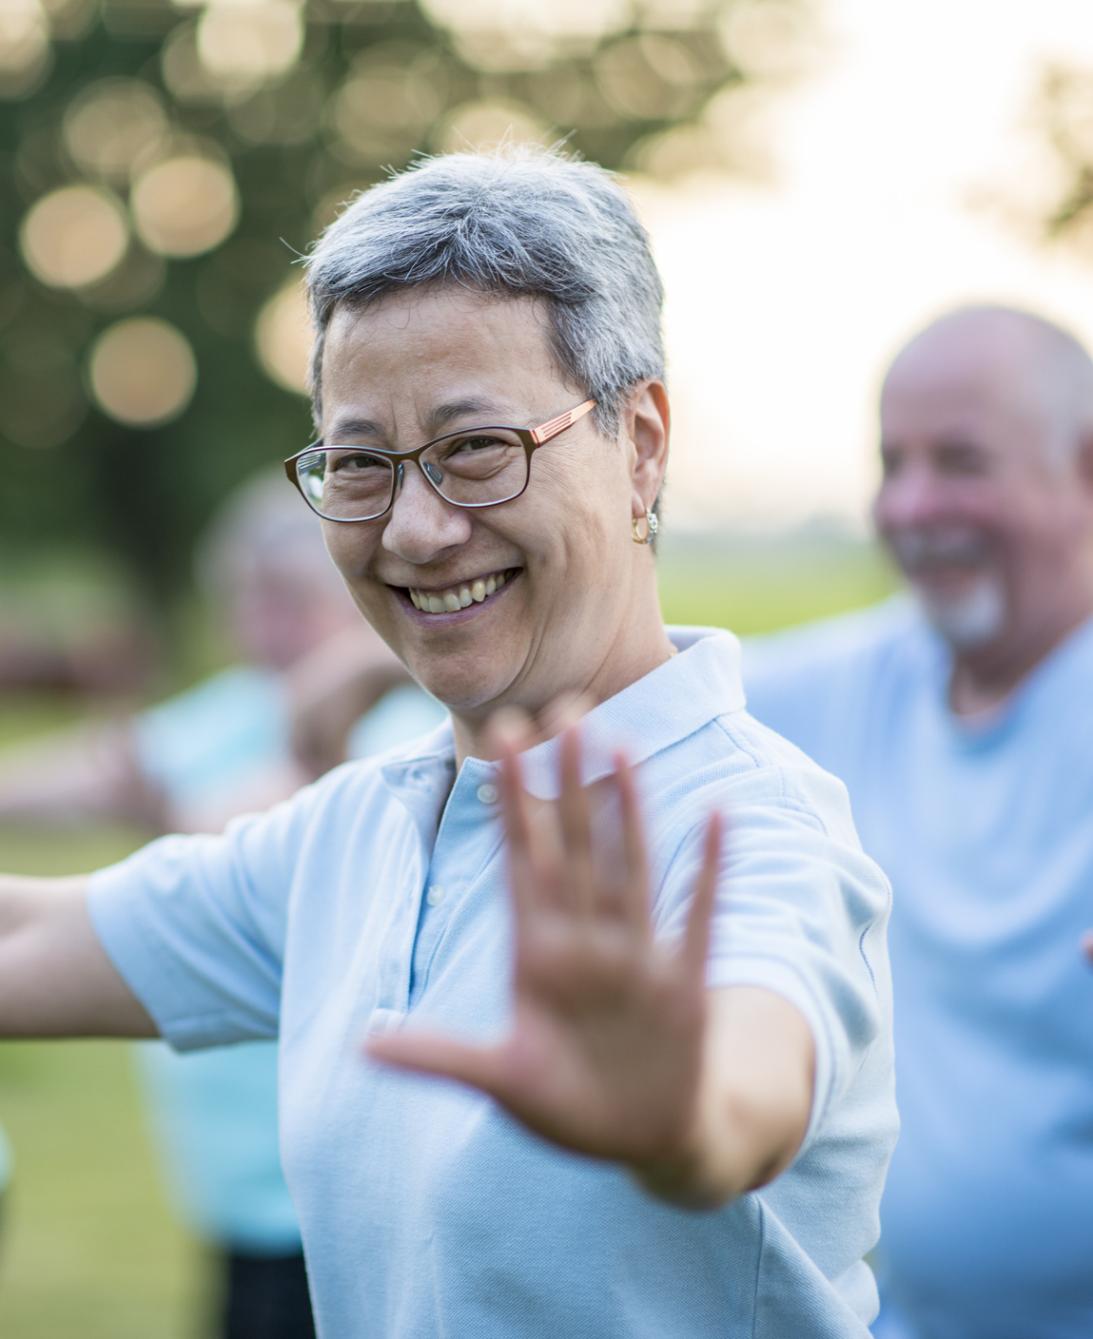
SilverSneakers
Access to Nationwide Fitness Locations
A free fitness benefit with access to thousands of fitness locations nationwide¹ including some group activities and classes offered outside the traditional fitness center setting
National Reciprocity
The ability to enroll at multiple locations at the same time – no limit to the number of locations where you participate
Signature SilverSneakers classes
Proprietary programming specifically designed for older adults to accommodate a wide range of interests and ability levels
Social Connections
Social opportunities where members can form genuine connections with others
Digital Offerings
Averaging 3,000 virtual events per week through SilverSneakers
On-Demand™ and SilverSneakers LIVE™ classes and workshops
Always talk with your doctor before starting an exercise program.
Participating locations (“PL”) are not owned or operated by Tivity Health, Inc. or its affiliates. Use of PL facilities and amenities is limited to terms and conditions of PL basic membership. Facilities and amenities vary by PL.

Slide 4
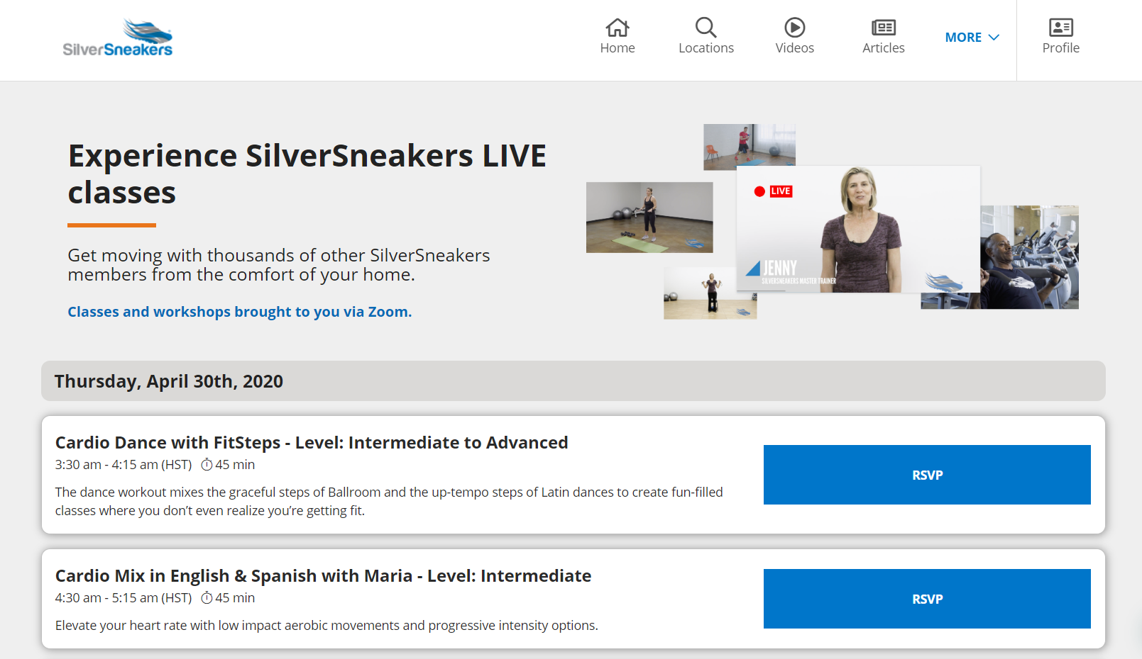
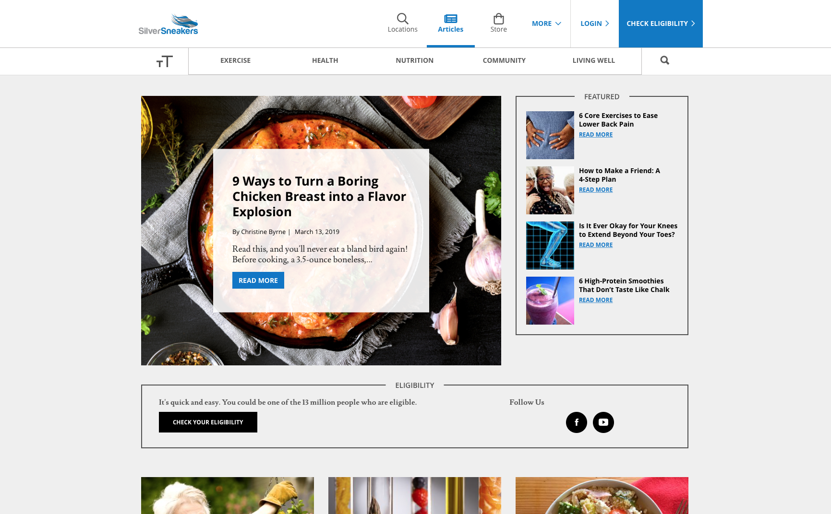
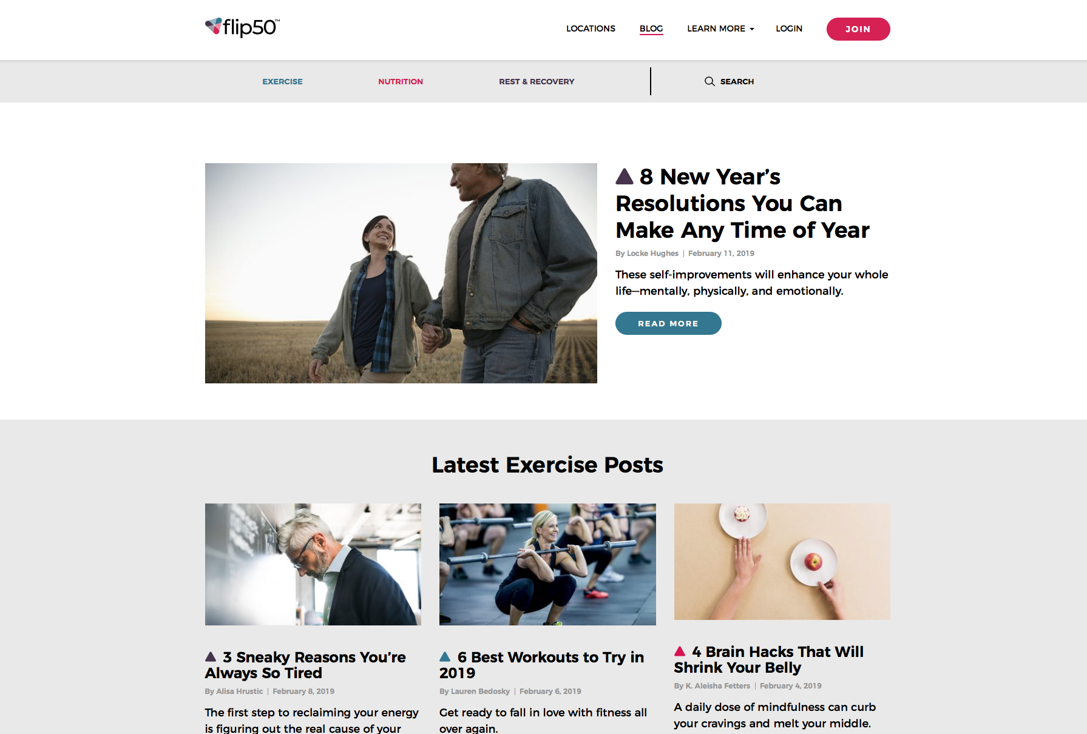
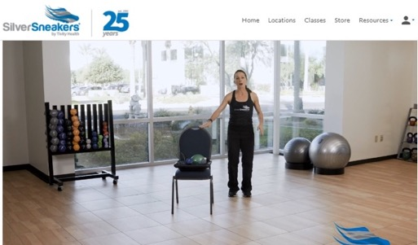
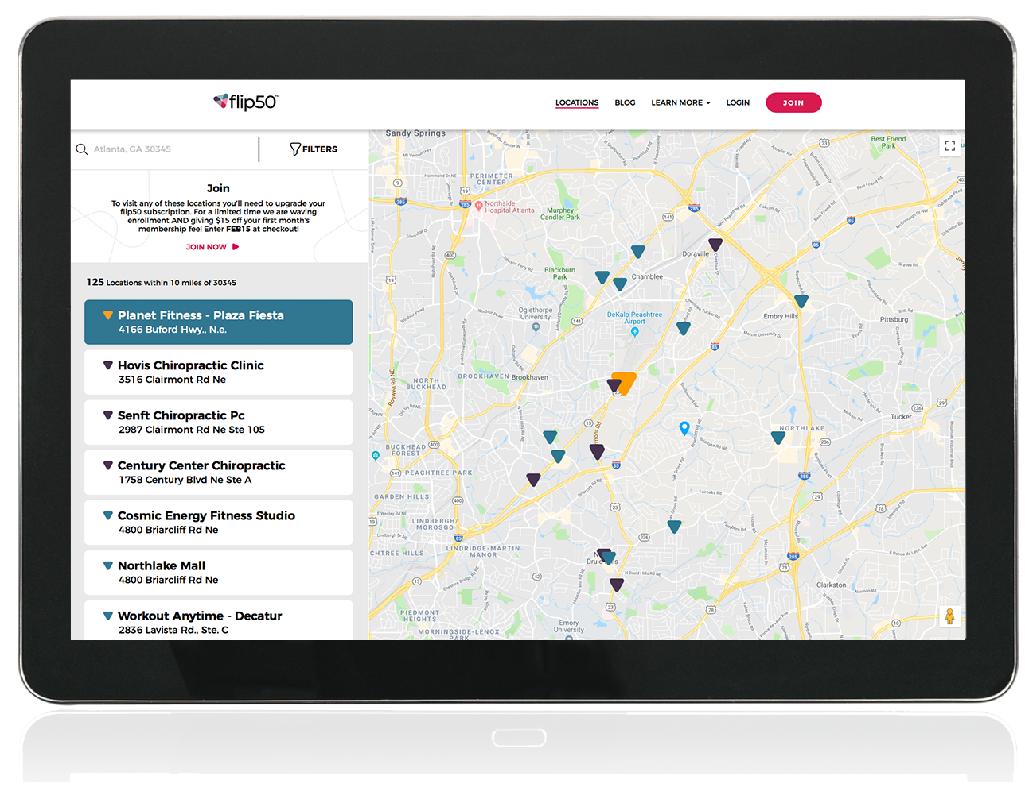
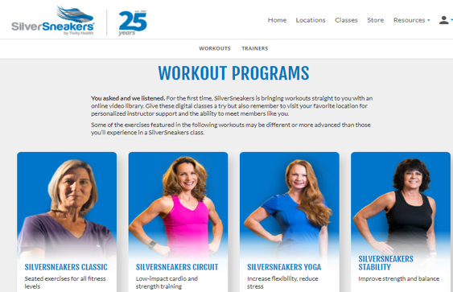
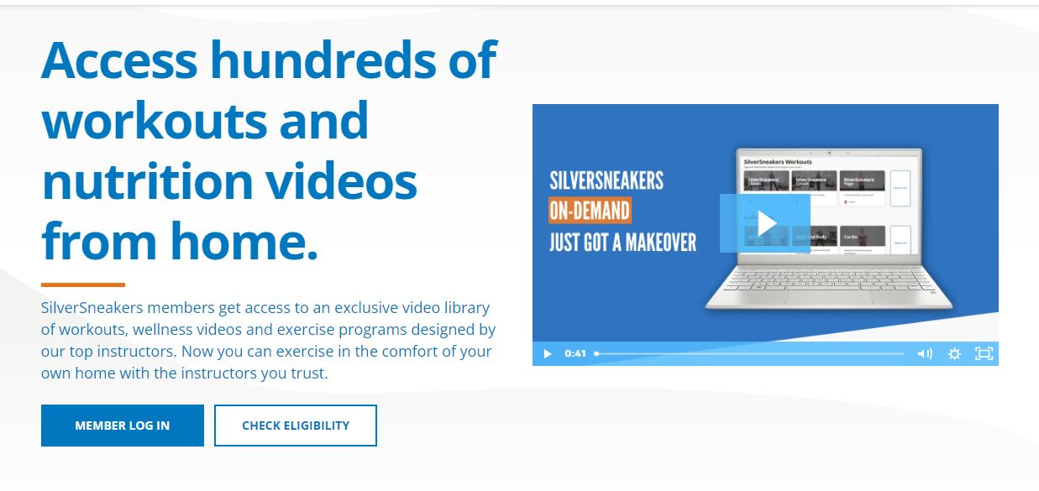
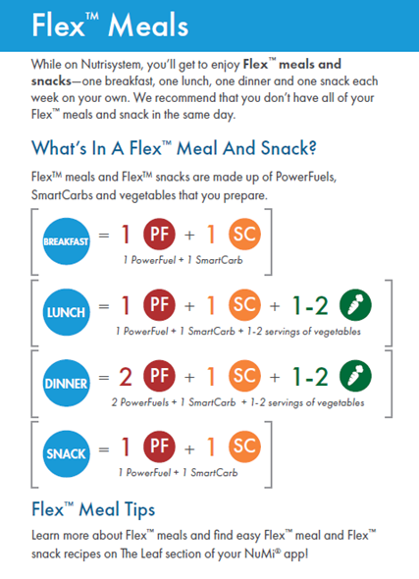
SilverSneakers Digital Features
Exclusive Member Portal
Enhancements to the SilverSneakers.com portal deliver fresh, relevant content to enhance overall health and wellbeing
SilverSneakers On-Demand™
Follow-along videos and programs with various formats to support cardiovascular strength, endurance, flexibility and mental health
Live Interactive Classes
SilverSneakers LIVE™ classes and workshops are offered daily, and are focused on exercise and overall wellbeing
SilverSneakers GO™
This mobile app is the SilverSneakers on the go companion, providing exercise guidance that can be adjusted based on ability
Notes:
Are you new to exercise? No Problem! There are hundreds on programs on SilverSneakers.com designed for every fitness level from beginner to advanced and special needs. Each class description will provide an overview of the class content. In fact, many classes can be done with assisted devices or a chair for added balance.
Are you an exercise enthusiast? Don’t worry, we have Live and OnDemand classes and programs for you, too.
What’s even more exciting is that all the programs are available on the GO with SilverSneakers Go app found in the Google Play and Apple App Store.

Slide 5
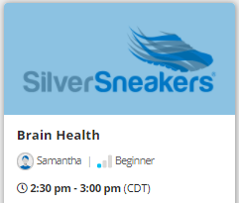
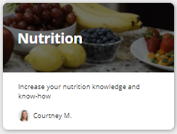
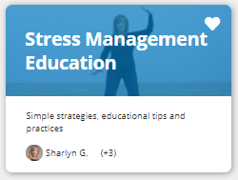
Beyond Fitness with SilverSneakers
Brain Health: Education, movement and practical tips designed to help preserve and enhance memory and brain health.
Fall Prevention: Programs supporting balance and stability to help prevent falls.
Stress Management Strategies: Mindfulness practices and educations tips designed to help you build resiliency and manage stress more effectively.
SilverSneakers BOOM MIND: The best of yoga, Pilates, and barre combined in a mind-body mat workout. Build endurance while increasing flexibility.
31-Day Fit for Life Challenge: SilverSneakers Fit for Life Challenge can help you get moving in the right direction with fun videos and great tips.
Nutrition: This series of videos will teach you the basics and provide you with tips on shopping, reading labels, deciding what to cook and more.
Emotional Wellbeing: Videos and articles providing tips and tools to manage stress, improve clarity and reduce anxiety.
Notes:
While on SilverSneakers.com, don’t forget to check out the volumes of information through OnDemand educational videos, programs on balance and fall prevention, and our incredible resources to help relax and manage stress. SilverSneakers is more than just a membership. It’s a place become healthy physically, emotionally and socially.

Slide 6
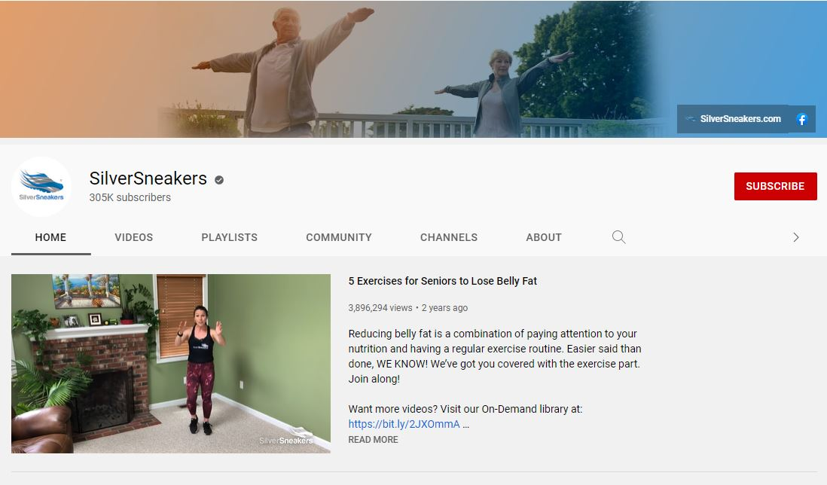
Non-Member Offerings
SilverSneakers YouTube
A variety of workouts, exercises and nutrition tips available to all
Hosted by several SilverSneakers instructors and partners
Senior-focused with varying levels of difficulty
www.youtube.com/user/TheSilverSneakers/
SilverSneakers Non-Member Accounts
SilverSneakers “fan” accounts available to those who are not yet eligible for membership
On-Demand fitness videos available 24/7
SilverSneakers GO™ mobile app with ability to track/log workouts

Slide 7
Rewards for Engagement
FREE access to College Tuition Discounts (more than 400 private colleges and universities)
Discounts spread over 4 years, good for up to 1 full year tuition
Participating location visits = Tuition Rewards Points
1,000 points at registration, 250 points each month with 7 visits
SilverSneakers.TuitionRewards.com
Notes:
Terms and Conditions – Tuition Rewards® are NOT awarded in cash. If all requirements have been met, by submitting the Tuition Rewards, you are guaranteeing that the student will be awarded scholarships, grants, or other awards at least equal to the amount of points submitted. Eligible students include children, grandchildren, and other students in your extended family who have not yet started 11th grade. Tuition Rewards that you earn must be transferred to/allocated to a student prior to August 31st of the year that the student begins 12th grade. A student’s Tuition Rewards must be submitted within 10 days of application to any participating college or university. Students must be admitted to participating colleges based upon standard admissions criteria. All program requirements, including deadlines and procedures, can be found in the Terms of Service at tuitionrewards.com. Tuition Rewards points take 60 days to be reflected in your account once your monthly visit requirement is met. You will receive 1,000 points immediately upon registering for your Tuition Rewards accounts. For the month you meet the requirement to visit a participating location at least seven times you will receive the 250 points for that month after 60 days. This schedule is repeated for every month you meet the seven-visit requirement. The SAGE Scholars Tuition Rewards program is offered and administered by an independent service provider, SAGE Scholars, Inc. SAGE Scholars, Inc. is not owned or operated by Tivity Health, Inc. or its affiliates.

Slide 8
Easy Enrollment Process
1
Locate your SilverSneakers Member ID (3 ways!)
Visit SilverSneakers.com and use the Check Your Eligibility link
Download our SilverSneakers GO app
Call our Member Experience Center and speak with one of our representatives at 1-888-423-4632 (TTY: 711) Monday-Friday 8 a.m. – 8 p.m. ET
2
Create a SilverSneakers Account & Enroll
Digitally, you can enroll at SilverSneakers.com and access:
SilverSneakers LIVE™
SilverSneakers On-Demand™
SilverSneakers GO™ Mobile App
At a participating location, take your SilverSneakers ID # and complete simple forms
3
That’s it! You’re ready to start getting active!
Notes:
Enroll and Active your membership today!
Once on SilverSneakers.com, sign up on your member portal where you can participate in the LIVE and OnDemand programs. When you are ready to go to the gym you can get your unique SilverSneakers ID number directly from your member portal. Simply write down your number or print it out. Take the number with you to the gym and you’re ready to start getting active.
If you’re using the SilverSneakers GO app, you can screen print your ID number right to your phone. It really is easy, as 1-2-3.
Enrollment is easy too. Once on SilverSneakers.com you can take LIVE and OnDemand programs easily.
on SilverSneakers.com. Simply write it down or print it out. If you are using SilverSneakers Go app, you can screen print your ID number right from the app. When you go to the gym, you simply give them your ID number and start working out. It really is as easy as 1-2-3.

Slide 9
Thank You
Notes:
On behalf of all of us at SilverSneakers, we look forward to seeing you virtually or in person soon.
Thank and we hope you stay healthy and safe.

