Slide 1
Move How You Want, When You Want With SilverSneakers®
Notes:
Hello and welcome to SilverSneakers the nation’s leading exercise program designed exclusively for you and available at no additional cost. Our goal today is to make sure you are familiar with all the ways you can use your SS benefit. Introduce your self and you co presenter.
(Please make your presentation personal, motivating, and inclusive whether they are beginners or avid exercisers. Think of it like you are presenting to your parents or grandparents. WE don’t need to insert a lot of stats but make sure they understand the basics and how special SS is and how it can improve their lives by participating. You can Share stories throughout the presentation, like our Swanson winners over the years and what they said/how SS changed their lives. https://www.google.com/search?q=2022+Richard+L+swanson+award+winner&rlz=1C1GCEA_enUS904US904&sxsrf=AOaemvJBBzdsXm-4qOhZqlSU2lzkN5Ah0A%3A1642792275316&ei=UwXrYcjZEviXwbkP1tyJ2AE&ved=0ahUKEwiIz4mQxsP1AhX4SzABHVZuAhsQ4dUDCA4&uact=5&oq=2022+Richard+L+swanson+award+winner&gs_lcp=Cgdnd3Mtd2l6EAM6BwgjELADECc6BwgjELACECdKBAhBGAFKBAhGGABQjgpY8RZg5CNoAXAAeACAAYABiAG_B5IBAzYuNJgBAKABAcgBAcABAQ&sclient=gws-wiz )
(Let them know we are so glad they joined us and that your copresenter will be answering questions in the chat or they can hold questions until the end.)

Slide 2
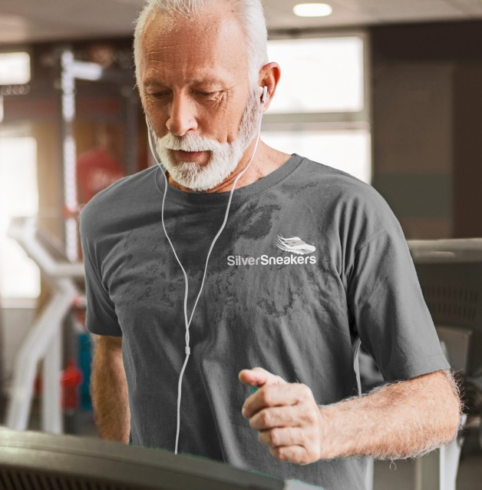
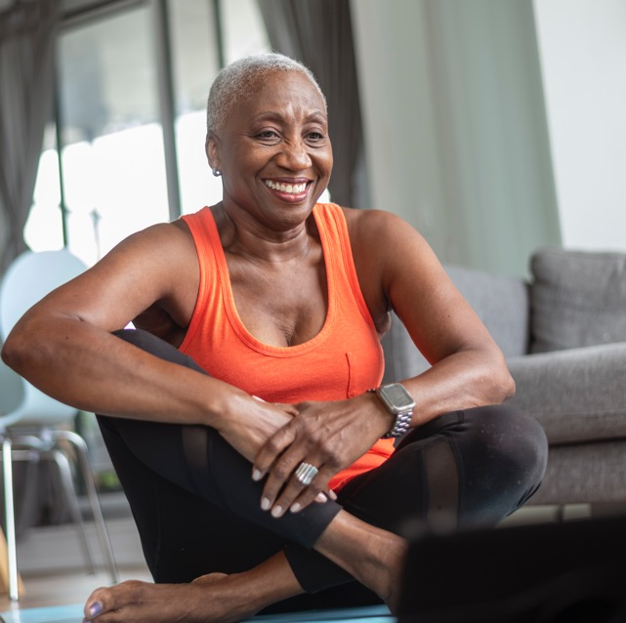
With SilverSneakers, you’re free to move:
IN THE GYM
AT HOME
IN YOUR COMMUNITY
Nationwide gym network with thousands of locations –
go to as many as you like
LIVE and On-Demand classes led by SilverSneakers trained instructors – convenience in the comfort of your home
Fitness options outside of the gym – recreation centers, walking groups, workshops and more in your community
Notes:
(Let them know we realize that everyone is different and have unique abilities and preferences when it comes to exercise. SilverSneakers has so much to offer. Whether they prefer to exercise at home, at the gym or the community, or a combination of the three, SilverSneakers has an option for them. Emphasize they don’t have to choose one or the other, they can do all or any)

Slide 3
SilverSneakers in the gym
Nationwide Network
Access thousands of participating locations nationwide¹ — enroll in as many as you like, at any time
Signature SilverSneakers classes
Enjoy classes designed by SilverSneakers instructors to meet a wide range of skill levels, interests and abilities
Social Connection
Be part of a local and national community of millions of adults who are staying active and living longer, healthier, happier lives
Always talk with your doctor before starting an exercise program.
Participating locations (“PL”) are not owned or operated by Tivity Health, Inc. or its affiliates. Use of PL facilities and amenities is limited to terms and conditions of PL basic membership. Facilities and amenities vary by PL.
Notes:
(Don’t forget to mention that they can take other classes at the location as they are available as part of a regular membership. Talk about the different amenities and it’s best to use the location finder on SilverSneakers.com to find and read about the different amenities that are available at each location.)

Slide 4
SilverSneakers at home
SilverSneakers LIVE
Enjoy online classes and workshops from the convenience and comfort of your own home. Classes are led by specially trained SilverSneakers instructors 7 days a week, with hundreds of classes each week for all levels and abilities.
Closed captioning is available.
Did You Know?
SilverSneakers offers an average of 3,000 online events each week through SilverSneakers LIVE and SilverSneakers On-Demand
SilverSneakers On-Demand
Access an exclusive online library of hundreds of workout classes, wellness videos and exercise programs for all interests and abilities. Watch when you want, as often as you like.
Notes:
Whether you’re a beginner or fitness enthusiast, SilverSneakers offers thousands of online classes and workshops designed for all fitness levels and abilities.
-- For LIVE highlight: Live, SilverSneakers Instructor led classes, and discuss how the instructor can help motivate etc. Join members of the SilverSneakers community across the country, in the comfort of your own home. In case it’s a concern, you will not be on camera for your workout. NEW classes added every month! Includes basics for strength, core and balance, plus new popular classes like Line Dancing, Kickboxing and so many more! There’s always something new to try on SS LIVE.
Pay video from “Let’s explore” text is linked to Wistia video. -- For On-Demand highlight: Library of work out videos and workshops available when you want to watch. -- Each class description will provide an overview of the class content. And many classes can be done with assisted devices or a chair for added support.

Slide 5
SilverSneakers in your community
Community Classes
Join group activities and classes¹ offered outside a traditional fitness center setting. Your membership includes access to:
Various venues such as medical centers, parks and community centers where older adults already gather
Classes taught by professionals trained in older adult fitness
Events including shared meals, holiday celebrations and class socials
1. Membership includes SilverSneakers instructor-led group fitness classes. Some locations offer members additional classes. Classes vary by location.

Slide 6
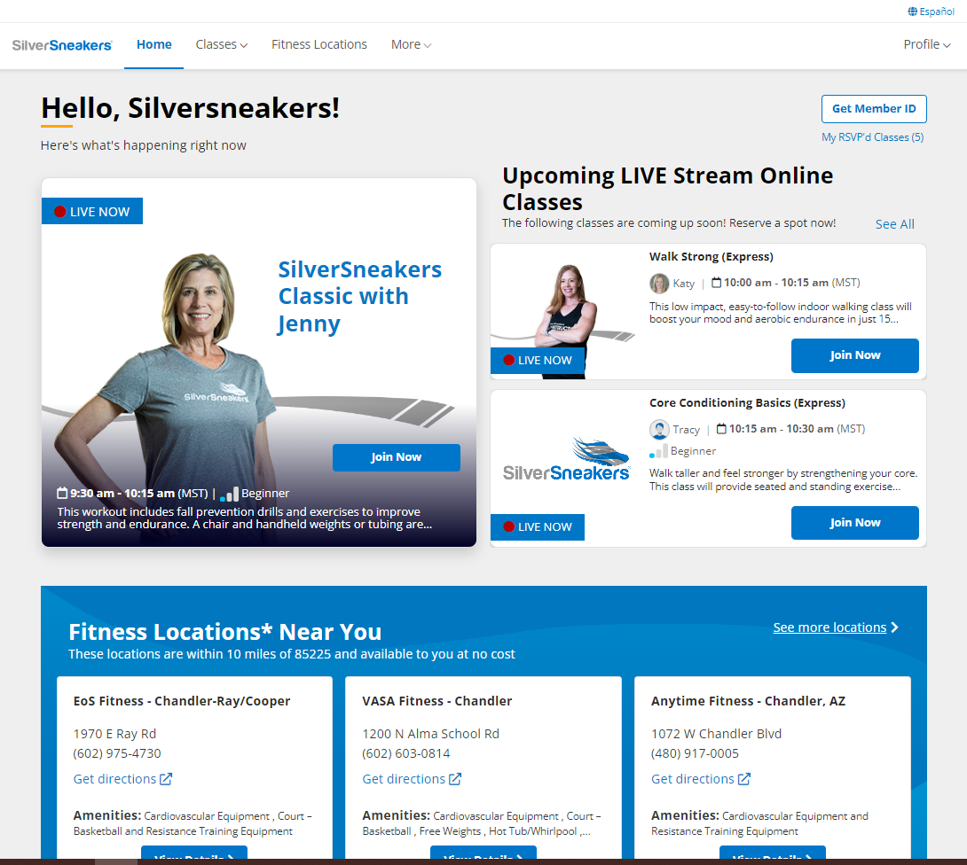
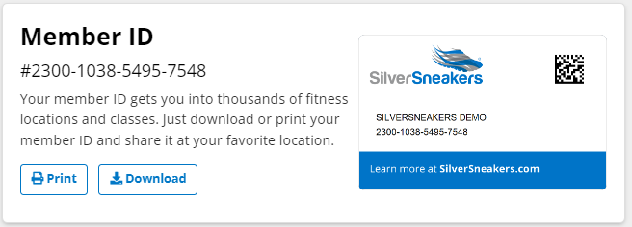
Resources at your fingertips
Click on the Español icon to translate SilverSneakers.com and Member Account Dashboard
The FREE SilverSneakers.com Member Account is the one-stop shop for:
Personalized member information like your 16-Digit SilverSneakers ID number
SilverSneakers LIVE classes, offered daily by SilverSneakers instructors
SilverSneakers On-Demand videos including specialized content & fitness challenges
Fitness locations near you and the location finder
Additional health & wellness programs made available to you by our partners like GetSetUp and Apple Fitness+
Featured articles and so much more!
Get your Member ID by clicking on Profile > Member ID -or- Get Member ID button
Notes:
While on SilverSneakers.com, don’t forget to check out the volumes of information through OnDemand educational videos, programs on balance and fall prevention, and our incredible resources to help relax and manage stress. SilverSneakers is more than just a membership. It’s a place where you can become healthy physically, emotionally and socially.
(Now would be a good time to show them through ss.com/member portal.) I would like to take a minute to show you through the member portal. I realize some of you may have looked around when you were registering for this class but I want to point out a few items just in case you missed it.
Share following the order of slides (go slow):
Gym locator
Classes tab: virtual classes (sorting feature) , Flex classes for those who want to take classes outside the gym locations, ondemand classes
More tab - articles
Go to “home” scroll down to App section – Ask them if we had a class on how to download and navigate the app. Would they be interested in attending. )
When doing the web demo point out that you may see different tiles than what my demo account has.
Follow the tiles to set up your free accounts/subscription on GSU or AF+ to gain access to even more content.

Slide 7
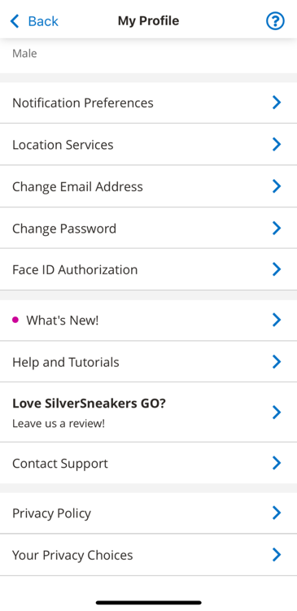
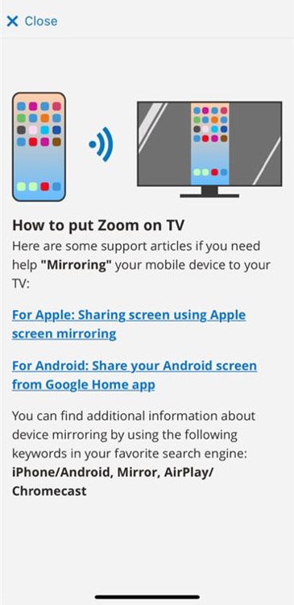
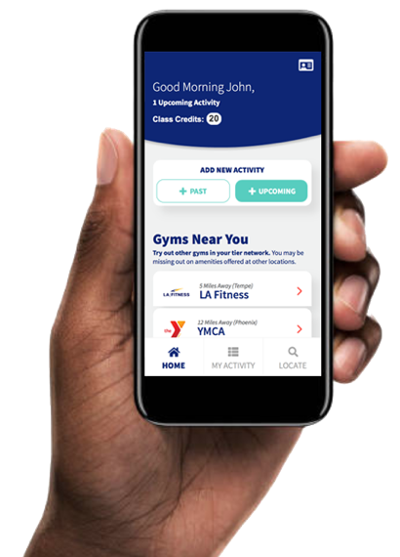
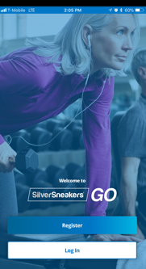
The SilverSneakers GO experience
The same member log in and resources as SilverSneakers.com
PLUS! View workouts on your smart TV:
Cast any SilverSneakers LIVE online class from your mobile device to your smart TV by selecting My Profile > Help and Tutorials. Follow the link for instructions specific to your mobile device.
SilverSneakers On-Demand classes include a “Chromecast” or “Airplay” option to cast videos from your device to a smart TV screen.
Notes:
What’s even more exciting is that all the programs are available on the GO with SilverSneakers GO app found in the Google Play and Apple App Store.
Play video from “Let’s explore” – text is linked to Wistia video

Slide 8
Earn rewards
FREE access to College Tuition Discounts (more than 400 private colleges and universities)
Discounts spread over 4 years, good for up to 1 full-year tuition
Participating location visits = Tuition Rewards Points
1,000 points at registration, 250 points each month with 7 visits*
SilverSneakers.TuitionRewards.com
* Valid through December 31, 2024
Notes:
Before we end the presentation today, we wanted to share this is a unique partnership we have with SAGE Scholars. (Recite the basics on the slide and encourage them to go to the website for more info. and to see the list of colleges and universities who participate.) (pause so they can write it down) We know that college an be quite expensive and this is a way that you could help contribute by participating in the live, virtual, instructor lead classes or attending a SS location.
(FYI: Terms and Conditions – Tuition Rewards® are NOT awarded in cash. If all requirements have been met, by submitting the Tuition Rewards, you are guaranteeing that the student will be awarded scholarships, grants, or other awards at least equal to the amount of points submitted. Eligible students include children, grandchildren, and other students in your extended family who have not yet started 11th grade. Tuition Rewards that you earn must be transferred to/allocated to a student prior to August 31st of the year that the student begins 12th grade. A student’s Tuition Rewards must be submitted within 10 days of application to any participating college or university. Students must be admitted to participating colleges based upon standard admissions criteria. All program requirements, including deadlines and procedures, can be found in the Terms of Service at tuitionrewards.com. Tuition Rewards points take 60 days to be reflected in your account once your monthly visit requirement is met. You will receive 1,000 points immediately upon registering for your Tuition Rewards accounts. For the month you meet the requirement to visit a participating location at least seven times you will receive the 250 points for that month after 60 days. This schedule is repeated for every month you meet the seven-visit requirement. The SAGE Scholars Tuition Rewards program is offered and administered by an independent service provider, SAGE Scholars, Inc. SAGE Scholars, Inc. is not owned or operated by Tivity Health, Inc. or its affiliates.)

Slide 9
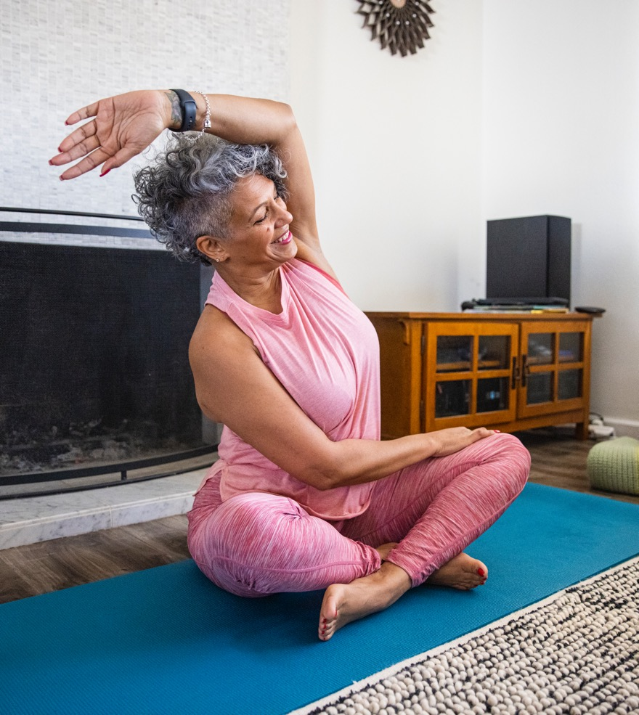
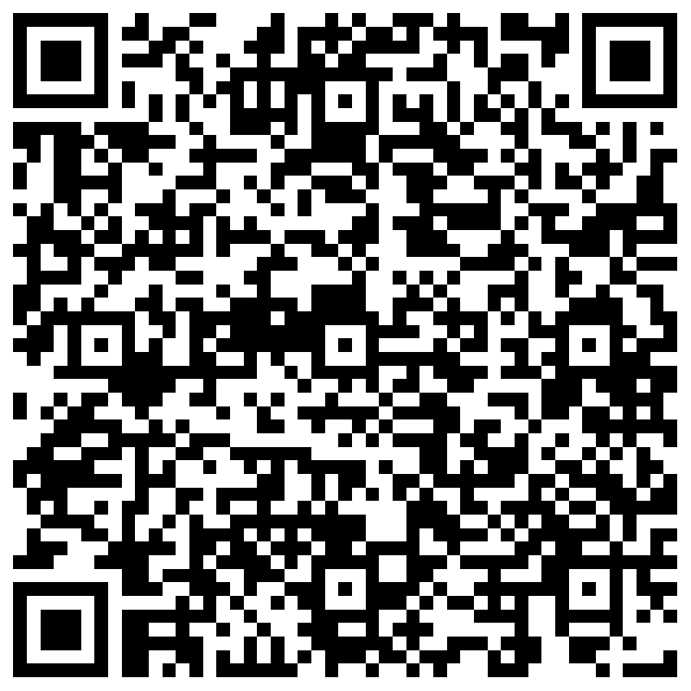
Let’s Get Started!
Hitting the gym?
Find a participating location near you and have your SilverSneakers Member ID number ready
Plan what you are going to wear and what to bring with you
Staying home?
Browse the SilverSneakers LIVE schedule and RSVP for a class (or two!)
Explore SilverSneakers On-Demand videos and find your favorites
SilverSneakers.com/LIVE

Slide 10
GET CONNECTED. STAY CONNECTED.
Use your SilverSneakers.com Member Account Dashboard
Make sure you receive our Weekly Newsletter
Join the conversation & get inspired on our Social Media
Have Questions? We are ready to help.
/SilverSneakers
/TheSilverSneakers
Call us: 1-888-423-4632 TTY 711, Español 1-888-617-6392
Email us: memberorientation@tivityhealth.com
Notes:
For Weekly Newsletter: -- You would have been signed up when you completed Eligibility Check and created your SilverSneakers.com account -- UNLESS you UN-checked the box to sign up. -- If you’re not receiving our Newsletter, go to SilverSneakers.com - In the top menu bar, select More > Articles > and then Subscribe to our newsletter by submitting your email address. You can unsubscribe at any time.

Slide 11
Thank you and welcome to SilverSneakers!
SilverSneakers is a registered trademark of Tivity Health, Inc. The SilverSneakers simplified flair shoe logotype is a trademark of Tivity Health, Inc. © 2024 Tivity Health, Inc. All rights reserved.
Notes:
We encourage you to register and try out any of the virtual classes that interest you or use our on demand library of classes. If you feel comfortable, visit one of our gym locations or attend a flex class in the community. Call first to see if there are any special instructions or covid protocols you will need to observe.
Ask in general what types classes they would like to see offered. (put it in the chat box)
General Q/A session while time remains.
On behalf of all of us at SilverSneakers, we look forward to seeing you virtually or in person soon. We hope you stay healthy and safe.

