Slide 1
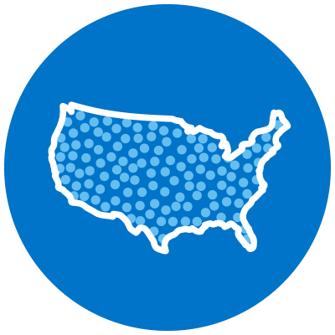
WITH SILVERSNEAKERS, YOU’RE FREE TO MOVE
In the Gym & Your Community
At Home or On The Go
Nationwide Network & Reciprocity
Access thousands of participating locations nationwide¹ — enroll in as many as you like, at any time
Signature SilverSneakers classes
Enjoy classes designed by SilverSneakers instructors to meet a wide range of skill levels, interests and abilities²
Social Connection
Be part of a local and national community of millions of adults who are staying active and living longer, healthier, happier lives
SilverSneakers LIVE
Join online classes for all levels & abilities, led by specially trained instructors 7 days a week
SilverSneakers On-Demand
Get access to hundreds of workout videos and workshops that you can view as often as you like
SilverSneakers GO mobile app
Download the perfect on-the-go companion that offers personalized resources, adjustable workout plans and more
Get Started by creating your FREE online account at SilverSneakers.com
Easily access your 16-digit Member ID, find fitness locations near you, join SilverSneakers LIVE classes, and so much more!
SilverSneakers is a registered trademark of Tivity Health, Inc. The SilverSneakers simplified flair shoe logotype is a trademark of Tivity Health, Inc. © 2024 Tivity Health, Inc. All rights reserved.
Participating locations (“PL”) are not owned or operated by Tivity Health, Inc. or its affiliates. Use of PL facilities and amenities is limited to terms and conditions of PL basic membership. Facilities and amenities vary by PL.
Membership includes SilverSneakers instructor-led group fitness classes. Some locations offer members additional classes. Classes vary by location.
Notes:
While on SilverSneakers.com, don’t forget to check out the volumes of information through OnDemand educational videos, programs on balance and fall prevention, and our incredible resources to help relax and manage stress. SilverSneakers is more than just a membership. It’s a place become healthy physically, emotionally and socially.

